Slide 1
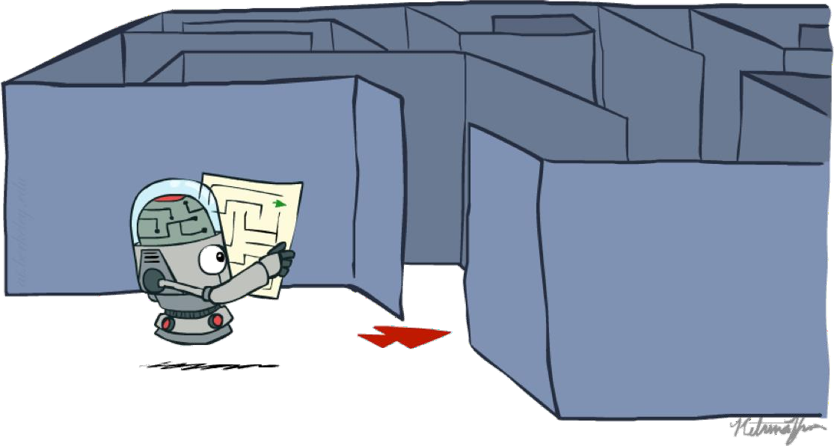
CS 860: Artificial Intelligence
Search
Instructors: Dr Soyiba Jawed
[Many of these slides were originally created by Dan Klein and Pieter Abbeel for CS188 Intro to AI at UC Berkeley (ai.berkeley.edu)]

Slide 2
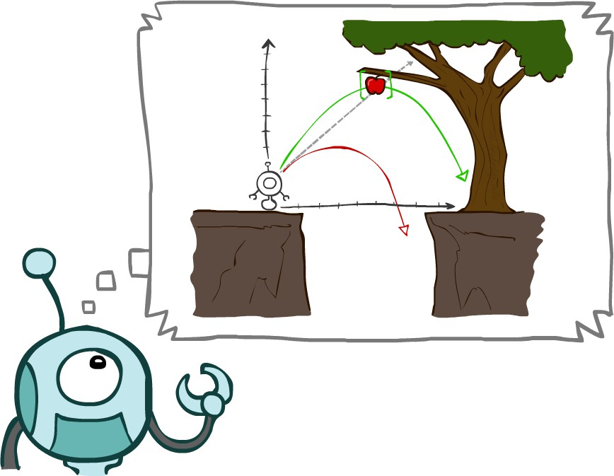
Today
Agents that Plan Ahead
Search Problems
Uninformed Search Methods
Depth-First Search
Breadth-First Search
Uniform-Cost Search

Slide 3
Agents that Plan

Slide 4

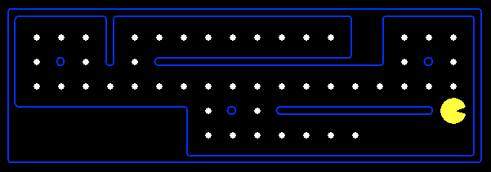
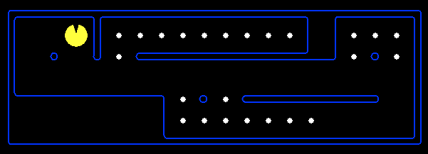
Reflex Agents
Reflex agents:
Choose action based on current percept (and maybe memory)
May have memory or a model of the world’s
current state
Do not consider the future consequences of their actions
Consider how the world IS
Can a reflex agent be rational?

Slide 5
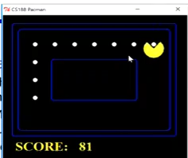
Demo Reflex: Optimal

Slide 6
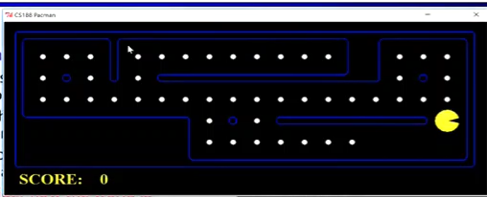
Demo Reflex: Suboptimal / Stuck

Slide 7

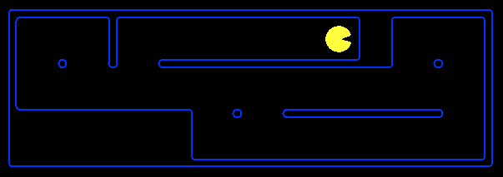
Planning Agents
Planning agents:
Ask “what if”
Decisions based on (hypothesized) consequences of actions
Must have a model of how the world evolves in response to actions
Must formulate a goal (test)
Consider how the world WOULD BE
Planning agents’ properties:
Completeness (or not)
Optimality (or not)
Planning vs. replanning

Slide 8
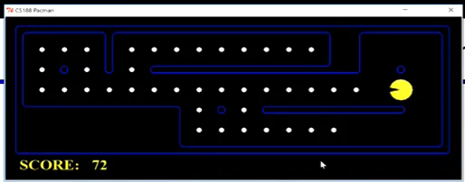
Video of Demo Replanning

Slide 9
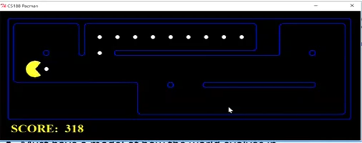
Video of Demo Mastermind

Slide 10

Search Problems

Slide 11

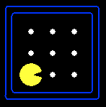





Search Problems
A search problem consists of:
A state space
A successor function
(with actions, costs)
“N”, 1.0
“E”, 1.0
A start state and a goal test
A solution is a sequence of actions (a plan) which transforms the start state to a goal state

Slide 12

Search Problems Are Models

Slide 13
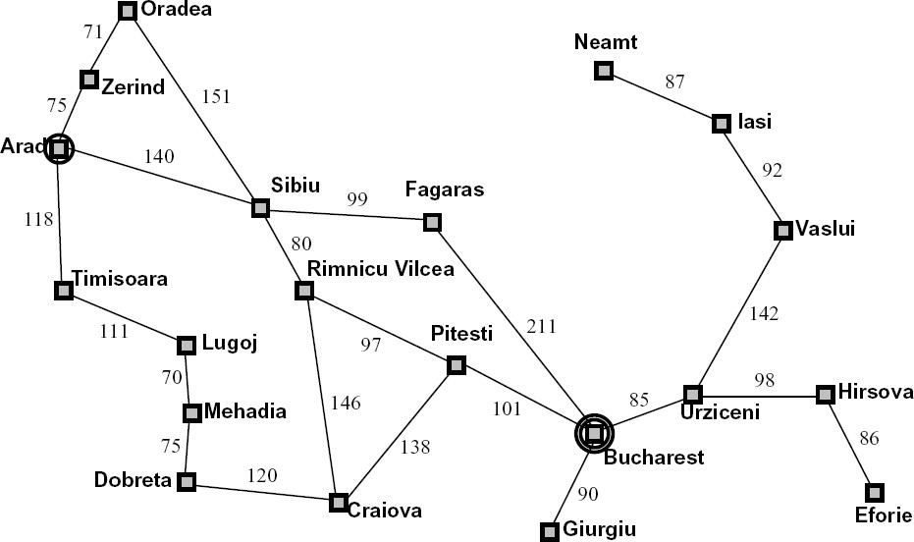
Example: Traveling in Romania
State space:
Cities
Successor function:
Roads: Go to adjacent city with cost = distance
Start state:
Arad
Goal test:
Is state == Bucharest?
Solution?

Slide 14
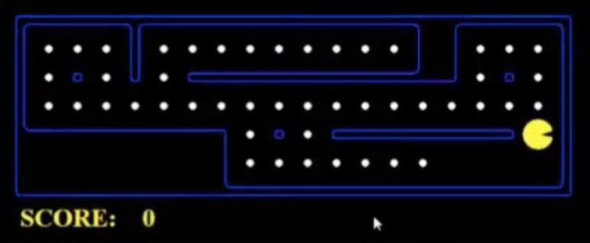
What’s in a State Space?
The world state includes every last detail of the environment
A search state keeps only the details needed for planning (abstraction)
▪
Problem: Pathing ▪
Problem: Eat-All-Dots
States: (x,y) location
Actions: NESW
Successor: update location only
Goal test: is (x,y)=END
States: {(x,y), dot booleans}
Actions: NESW
Successor: update location and possibly a dot boolean
Goal test: dots all false

Slide 15
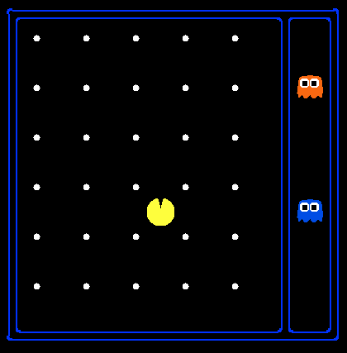
State Space Sizes?
World state:
Agent positions: 120
Food presence: 30 booleans
Ghost positions: 12
Agent facing: NESW
How many
World states?
120x(2³⁰)x(12²)x4
States for pathing? 120
States for eat-all-dots?
120x(2³⁰)

Slide 16
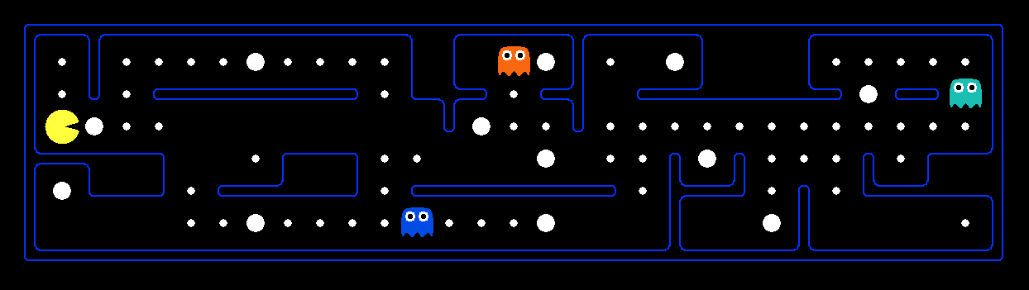
Safe Passage
Problem: eat all dots while keeping the ghosts perma-scared
What does the state space have to specify?
(agent position, dot booleans, power pellet booleans, remaining scared time)

Slide 17
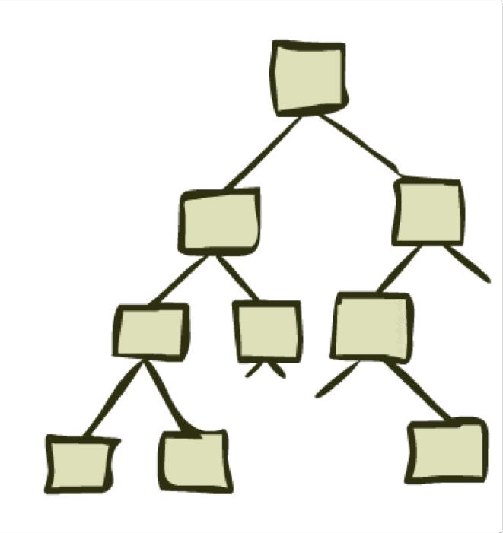
State Space Graphs and Search Trees

Slide 18




State Space Graphs
State space graph: A mathematical representation of a search problem
Nodes are (abstracted) world configurations
Arcs represent successors (action results)
The goal test is a set of goal nodes (maybe only one)
In a state space graph, each state occurs only once!
We can rarely build this full graph in memory (it’s too big), but it’s a useful idea

Slide 19
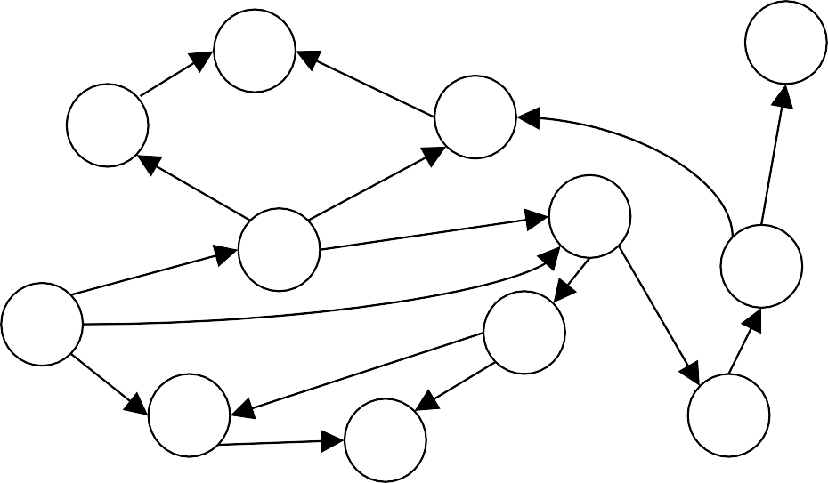
State Space Graphs
State space graph: A mathematical representation of a search problem
a
G
Nodes are (abstracted) world configurations
Arcs represent successors (action results)
The goal test is a set of goal nodes (maybe only one)
b
c
e
d
f
S
h
In a state space graph, each state occurs only once!
p
r
q
Tiny state space graph for a tiny search problem
We can rarely build this full graph in memory (it’s too big), but it’s a useful idea

Slide 20
Search Trees
This is now / start
“N”, 1.0
“E”, 1.0
Possible futures
A search tree:
A “what if” tree of plans and their outcomes
The start state is the root node
Children correspond to successors
Nodes show states, but correspond to PLANS that achieve those states
For most problems, we can never actually build the whole tree

Slide 21
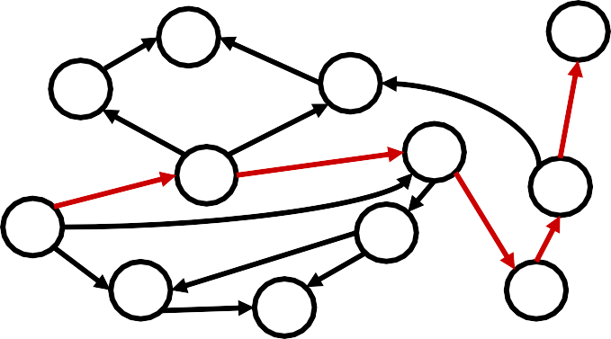
State Space Graphs vs. Search Trees
State Space Graph
Each NODE in in the search tree is an entire PATH in the state space graph.
Search Tree
S
a
G
d
e
p
b
c
q
b
c
e
h
r
d
e
p q f
q
f
a
a
h
r
S
h
We construct both on demand – and we construct as little as possible.
p q f
q
c
a
p
r
G
q
c a
G

Slide 22

Quiz: State Space Graphs vs. Search Trees
Consider this 4-state graph:
How big is its search tree (from S)?
a
S
G
b

Slide 23
Quiz: State Space Graphs vs. Search Trees
Consider this 4-state graph:
How big is its search tree (from S)?
a
s
a
b
S
G
b G a G
b
a G b G
… …
Important: Lots of repeated structure in the search tree!

Slide 24
Tree Search

Slide 25
Search Example: Romania

Slide 26
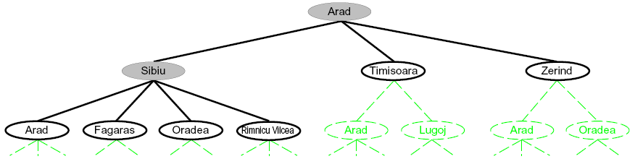
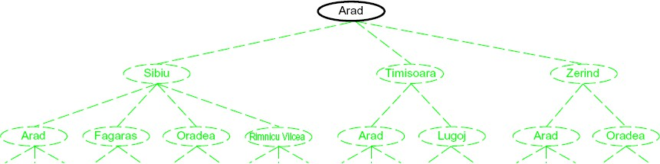
Searching with a Search Tree
Search:
Expand out potential plans (tree nodes)
Maintain a fringe of partial plans under consideration
Try to expand as few tree nodes as possible

Slide 27
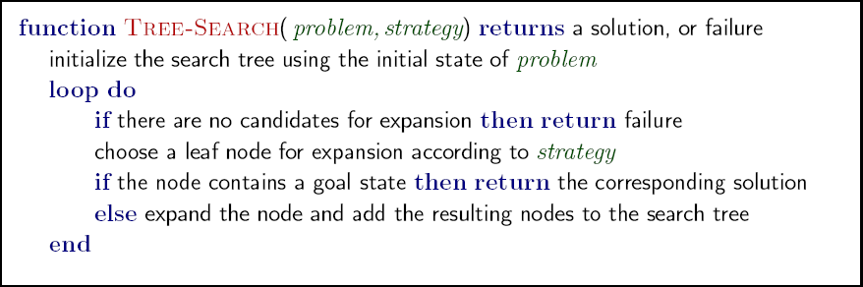
General Tree Search
Important ideas:
Fringe
Expansion
Exploration strategy
Main question: which fringe nodes to explore?

Slide 28
Example: Tree Search
a
G
b
c
d
e
f
S
h
p
q
r

Slide 29
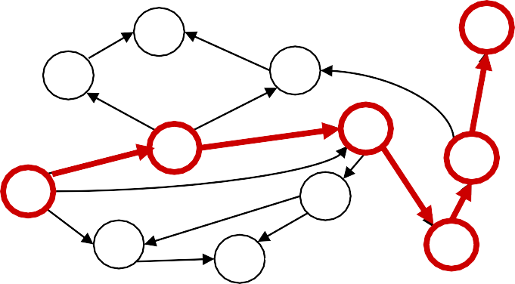
Example: Tree Search
a
G
b
c
d
e
f
S
h
p
q
r
S
s
s → d
d
e
p
s → e s → p
s → d → b s → d → c s → d → e
b
c
e
h
r
q
a
a
h
r
p q f
s → d → e → h s → d → e → r
p q f
q
c
a
G
q
c
a
s → d → e → r → f
G
s → d → e → r → f → c s → d → e → r → f → G

Slide 30
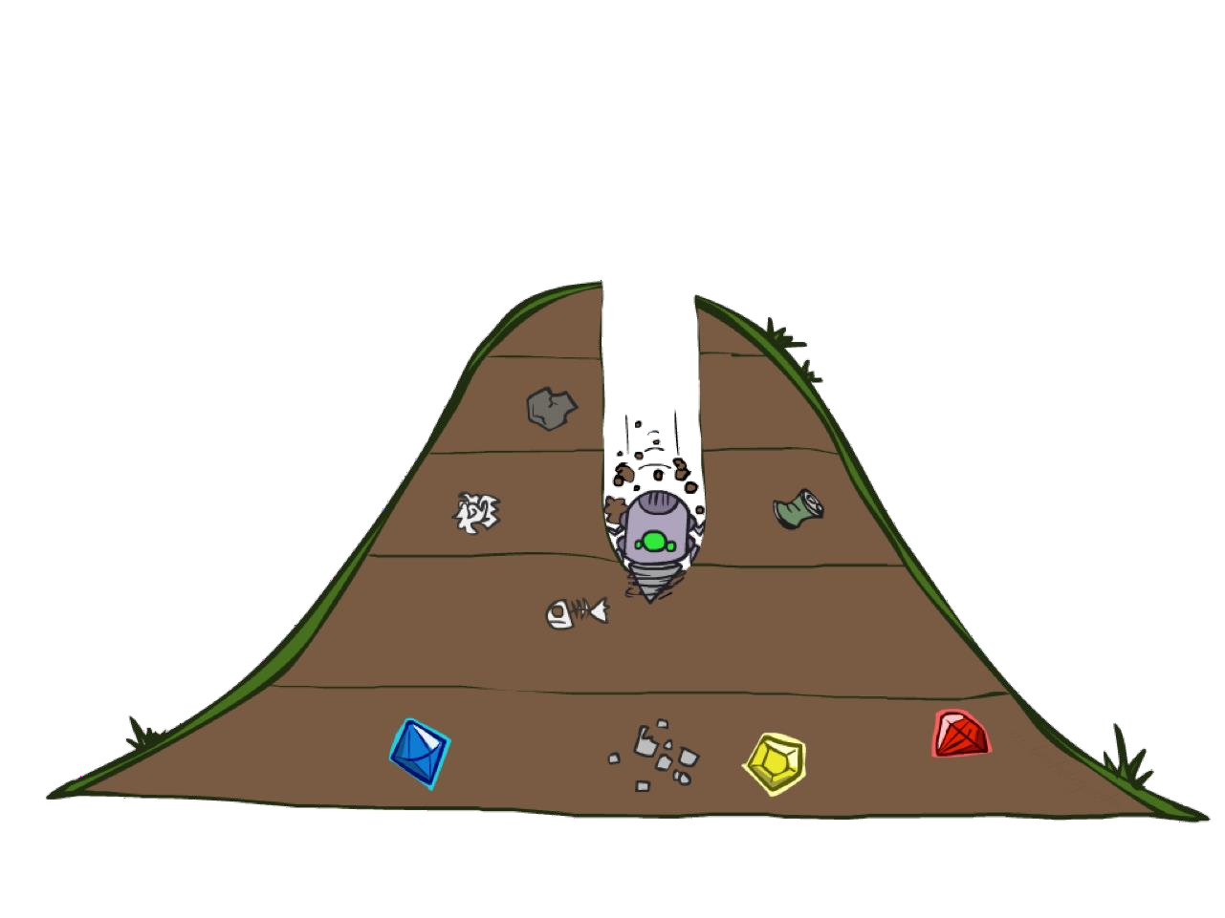
Depth-First Search

Slide 31
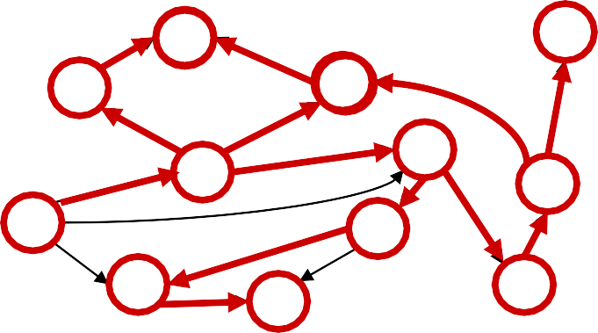
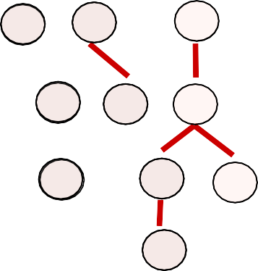
Depth-First Search
Strategy: expand a deepest node first
Implementation: Fringe is a LIFO stack
a
G
bb
c
d
e
f
S
h
pp
q
r
S
d
e
p
b
c
e
h
r
q
a
a
h
r
p q f
p q f
q
c
a
G
q
c
a
G

Slide 32
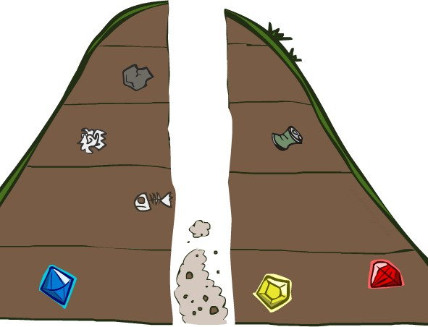
Search Algorithm Properties

Slide 33




Search Algorithm Properties
Complete: Guaranteed to find a solution if one exists?
Optimal: Guaranteed to find the least cost path?
Time complexity?
Space complexity?
1 node
b nodes
b² nodes
b
…
Cartoon of search tree:
b is the branching factor
m is the maximum depth
solutions at various depths
m tiers
b^{m} nodes
Number of nodes in entire tree?
1 + b + b² + …. b^{m} = O(b^{m})

Slide 34
Depth-First Search (DFS) Properties
What nodes does DFS expand?
Some left prefix of the tree.
Could process the whole tree!
If m is finite, takes time O(b^{m})
1 node b nodes
b² nodes
b
…
How much space does the fringe take?
Only has siblings on path to root, so O(bm)
Is it complete?
m could be infinite, so only if we prevent cycles (more later)
m tiers
b^{m} nodes
Is it optimal?
No, it finds the “leftmost” solution,
regardless of depth or cost

Slide 35
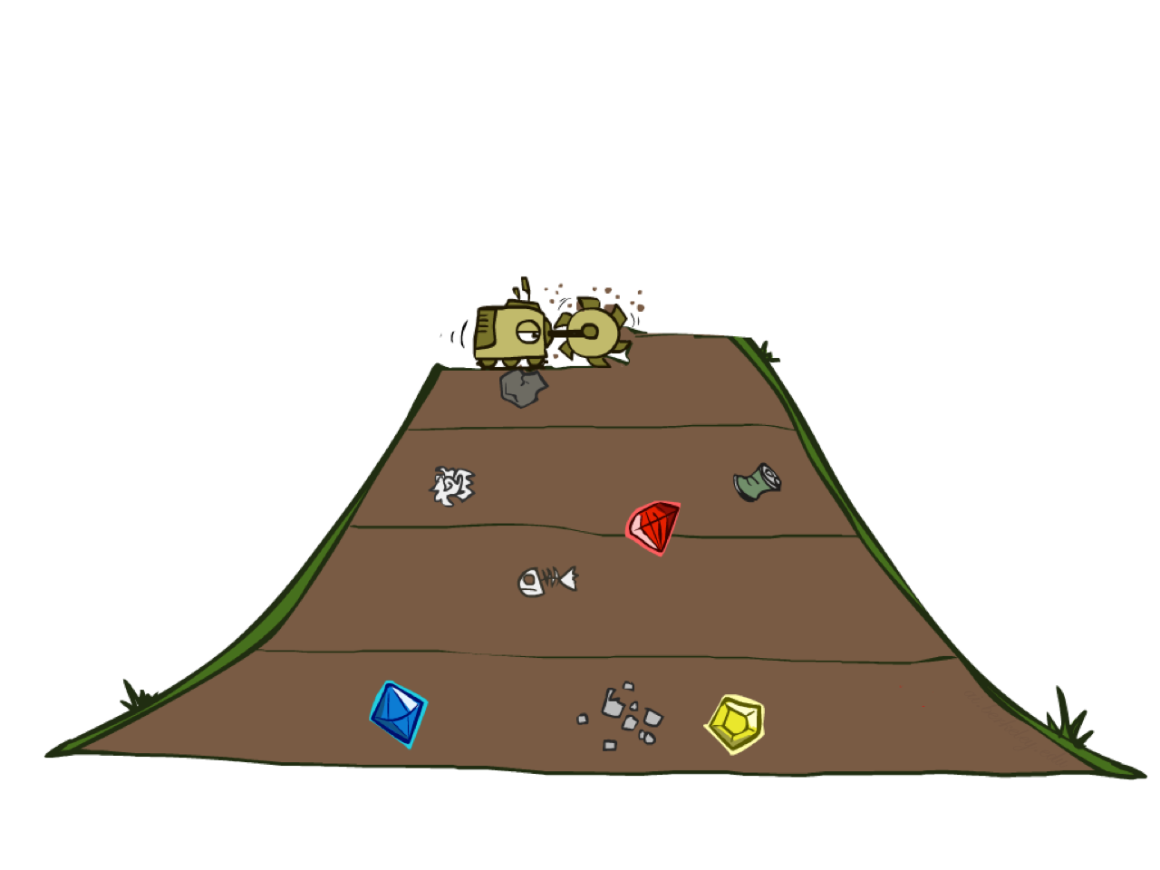
Breadth-First Search

Slide 36
Breadth-First Search
Strategy: expand a shallowest node first
Implementation: Fringe is a FIFO queue
a
G
b
c
d
e
f
S
h
p
q
r
S
d
b c e h r
e p
Search Tiers
q
a a h r p q f
q f
c
a
q c
G
G
a

Slide 37


Breadth-First Search (BFS) Properties
What nodes does BFS expand?
Processes all nodes above shallowest solution
Let depth of shallowest solution be s
Search takes time O(b^{s})
1 node b nodes
b² nodes
b
…
s tiers
How much space does the fringe take?
Has roughly the last tier, so O(b^{s})
Is it complete?
s must be finite if a solution exists, so yes!
Is it optimal?
Only if costs are all 1 (more on costs later)
b^{s} nodes
b^{m} nodes

Slide 38
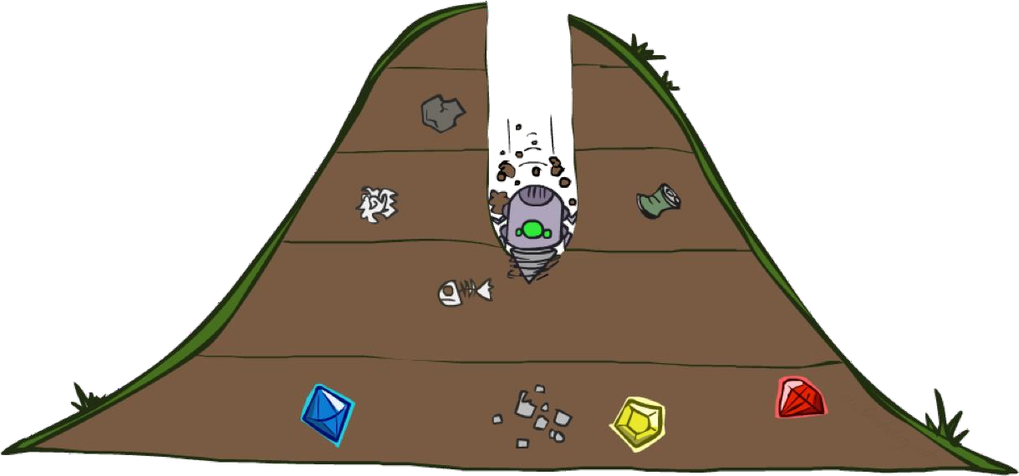
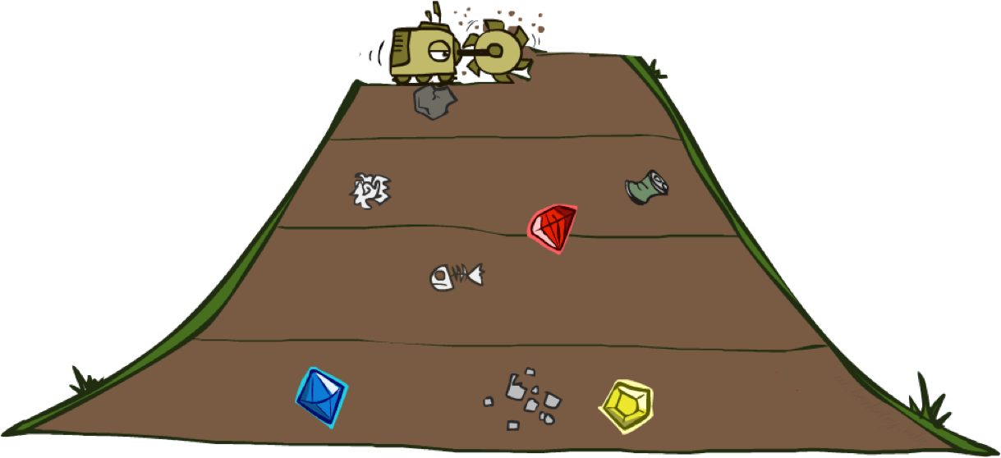
Quiz: DFS vs BFS

Slide 39
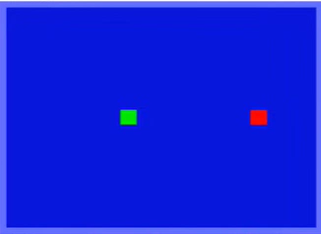
Video of Demo Maze Water DFS/BFS (part 1)

Slide 40
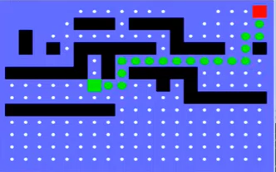
Video of Demo Maze Water DFS/BFS (part 2)

Slide 41
Quiz: DFS vs BFS
When will BFS outperform DFS?
When will DFS outperform BFS?

Slide 42


Iterative Deepening
Idea: get DFS’s space advantage with BFS’s time / shallow-solution advantages
Run a DFS with depth limit 1. If no solution…
Run a DFS with depth limit 2. If no solution…
Run a DFS with depth limit 3. …..
b
…
Isn’t that wastefully redundant?
Generally most work happens in the lowest level searched, so not so bad!

Slide 43
Cost-Sensitive Search
a
GOAL
2
2
b
c
3
2
1
8
2
e
3
d
f
9
8
2
START
h
1
4
2
p
4
r
15
q
BFS finds the shortest path in terms of number of actions.
It does not find the least-cost path. We will now cover a similar algorithm which does find the least-cost path.

Slide 44

Uniform Cost Search

Slide 45
Uniform Cost Search
2
a
G
Strategy: expand a cheapest node first:
b
c
1
8
2
2
e
_{h} 8
3
d
f
Fringe is a priority queue (priority: cumulative cost)
9
2
S
1
1
p
q
r
15
S 0
e
d
3
9
p
1
e
5
h 17 11
q 16
b 4
^{c} 11
a
r
Cost contours
6
h
13 7
a
r
p q f
p q f
8
q
c
a
G
q
11
c
a
G
10

Slide 46



Uniform Cost Search (UCS) Properties
What nodes does UCS expand?
Processes all nodes with cost less than cheapest solution!
If that solution costs C* and arcs cost at least ε , then the “effective depth” is roughly C*/ε
Takes time O(b^{C*/ε}) (exponential in effective depth)
How much space does the fringe take?
Has roughly the last tier, so O(b^{C*/ε})
b
c ≤ 1
c ≤ 2
c ≤ 3
…
C*/ε “tiers”
Is it complete?
Assuming best solution has a finite cost and minimum arc cost is positive, yes!
Is it optimal?
Yes

Slide 47






Uniform Cost Issues
Remember: UCS explores increasing cost contours
…
c ≤ 1
c ≤ 2
c ≤ 3
The good: UCS is complete and optimal!
The bad:
Explores options in every “direction”
No information about goal location
Start
Goal
We’ll fix that soon!

Slide 48
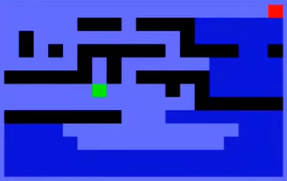
Video of Demo Empty UCS

Slide 49

The One Queue
All these search algorithms are the same except for fringe strategies
Conceptually, all fringes are priority queues (i.e. collections of nodes with attached priorities)
Practically, for DFS and BFS, you can avoid the log(n) overhead from an actual priority queue, by using stacks and queues
Can even code one implementation that takes a variable queuing object

Slide 50
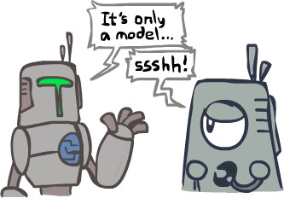
Search and Models
Search operates over models of the world
The agent doesn’t actually try all the plans out in the real world!
Planning is all “in simulation”
Your search is only as good as your models…

